Slide 1
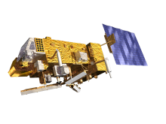
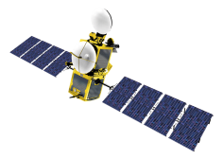
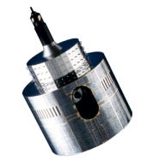
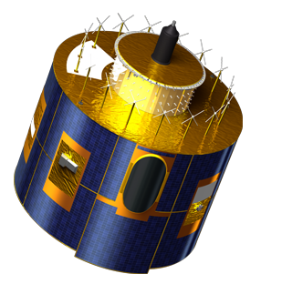
EUMETSAT’s Launch plans and
Future service enhancements
GEO Symposium
26 April 2014
Kim-Hui Gaune,
User Support Officer

Slide 2
Contents
Overview on current EUMETSAT satellites and future satellite launch plans
Future service enhancements:
New Web Imagery Service
New Data Centre Ordering Client
User Notification Service 2.0

Slide 3
Contents
Overview on current EUMETSAT satellites and future satellite launch plans
Future service enhancements:
New Web Imagery Service
New Data Centre Ordering Client
User Notification Service 2.0

Slide 4
Current EUMETSAT satellites
METOP-A (98.7° incl.)
JASON-2 (66° incl.)
EUMETSAT POLAR SYSTEM
OCEAN SURFACE TOPOGRAPHY
Kept in its nominal mid-morning sun synchronous orbit at 817km altitude. Providing Global and Regional Data Service, as well as Direct Readout Service.
Kept in its nominal non-synchronous low Earth orbit at 1,336km altitude, in support of the Ocean Surface Topography Mission.
METOP-B
METOP-A
JASON-2
METOP-B (98.7° incl.)
EUMETSAT POLAR SYSTEM
Launched on 17/09/2012.
Primary Metop satellite. Providing Global and Regional Data Service, as well as Direct Readout Service.
METEOSAT-7 (57° EAST)
INDIAN OCEAN DATA COVERAGE
METEOSAT-7
Operated in support of the Indian Ocean Data Coverage (IODC) mission, bridging an observational gap in this region
METEOSAT-10 (0°)
METEOSAT-9 (9.5° EAST)
METEOSAT-8 (3.5° EAST)
METEOSAT FULL DISC IMAGERY
RAPID SCANNING SERVICE (RSS)
Launched on 05/07/2012. Delivering prime Meteosat full disc imagery service over the European continent, Africa and parts of the Atlantic and Indian oceans.
Delivering the Rapid Scanning Service (RSS) over Europe and adjacent seas.
Back-up service for 0° and RSS.
METEOSAT-10
METEOSAT-9
METEOSAT-8

Slide 5
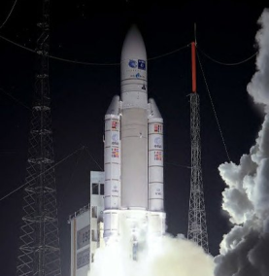
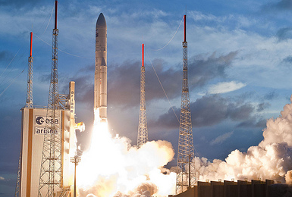
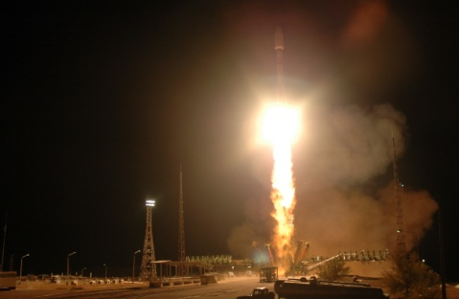
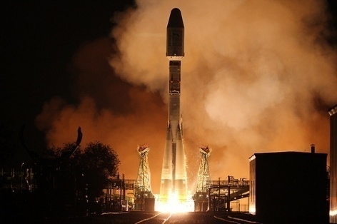
Deploying the remaining MSG and Metop satellites
MSG-1 (Meteosat-8) launch
28 August 2002
MSG-2 (Meteosat-9) launch
21 December 2005
MSG-3 (Meteosat-10) launch
5 July 2012
METEOSAT SECOND GENERATION
METEOSAT-8
METEOSAT-9
METEOSAT-10
MSG-4/METEOSAT-11
YEAR...
2002
2003
2004
2005
2006
2007
2008
2009
2010
2011
2012
2013
2014
2015
2016
2017
2018
2019
2020
2021
2022
2023
2024
2025
EUMETSAT POLAR SYSTEM (EPS)
METOP-A
METOP-B
METOP-C
Metop-A launch
19 October 2006
Metop-B launch
17 September 2012

Slide 6
EUMETSAT mission planning
YEAR...
03
04
05
06
07
08
09
10
11
12
13
14
15
16
17
18
19
20
21
22
23
24
25
26
27
28
29
30
31
32
33
34
35
36
37
38
39
40
METEOSAT FIRST GENERATION
METEOSAT-7
METEOSAT SECOND GENERATION
METEOSAT-8
METEOSAT-9
METEOSAT-10
MSG-4/METEOSAT-11*
METEOSAT THIRD GENERATION (MTG)
MTG-I-1
MTG-S-1
MTG-I-2
MTG-I-3
MTG-S-2
MTG-I-4
EUMETSAT POLAR SYSTEM (EPS)
METOP-A
METOP-B
METOP-C
EPS-SECOND GENERATION (EPS-SG)
METOP-SG SOUNDING & IMAGERY SATELLITES
METOP-SG MICROWAVE SATELLITES
JASON
JASON-2
JASON-3
JASON CONTINUITY OF SERVICES (JASON-CS)
Only the full operational phase of each mission is represented, excluding commissioning.
* MSG-4/Meteosat-11 will be stored in orbit, before replacing Meteosat-10

Slide 7
Contents
Overview on current EUMETSAT satellites and future satellite launch plans
Future service enhancements:
New Web Imagery Service
New Data Centre Ordering Client
User Notification Service 2.0

Slide 8
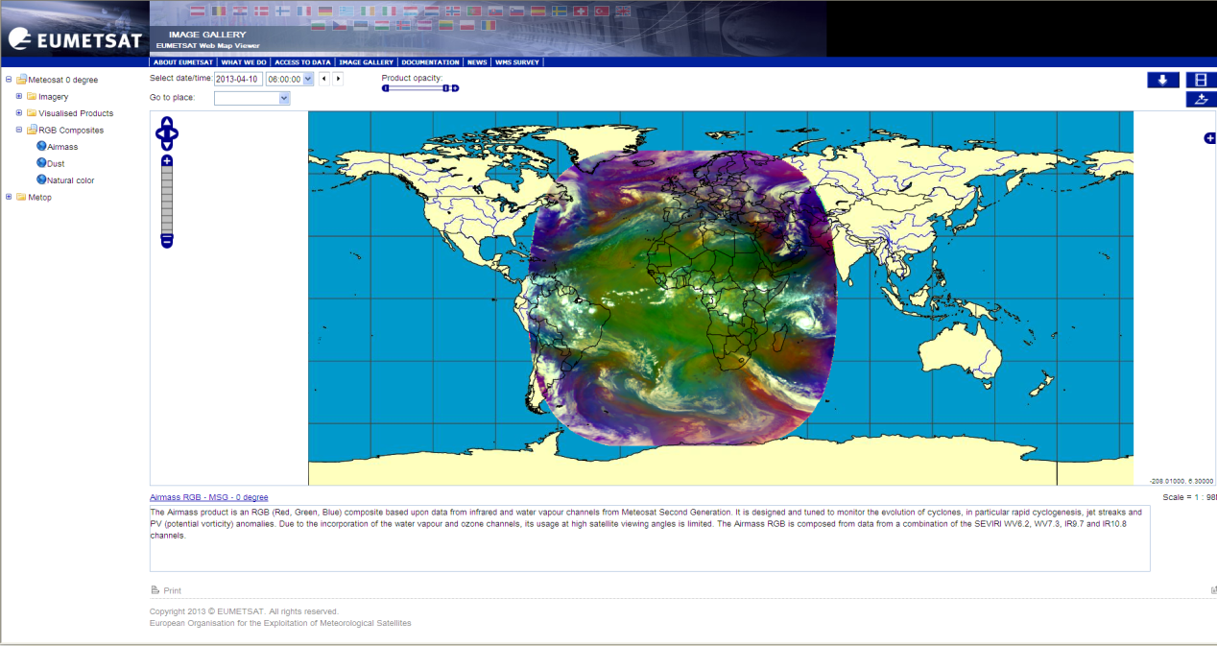
New Web Imagery Service
A new service to visualise EUMETSAT satellite data has been beta-tested.
The service makes use of the OGC Web Map Service (WMS) specification, which allows users to see satellite imagery in a standard, interoperable way.
Key features of the WMS
Provides a simple view of
EUMETSAT’s satellite products
Allows easy regional selection,
overlay of products on World Map background
Imagery available in various formats
OGC standards allow for easy exchange
of imagery between web map viewer providers
This new service is intended to replace the existing web imagery service
It will mirror the contents of the existing service:
Meteosat and Metop imagery, RGB composites and other visualised products

Slide 9
New Web Imagery Service
Next steps:
Transition to operational pilot in Q4 2014
Release the service in parallel to the existing web imagery service (for a few months)
Phase out existing imagery service
Additional features being considered (based on feedback from beta testers):
Longer archive of imagery (full archive for 3 months, selected imagery for longer periods)
FTP service to support image download.

Slide 10
Contents
Overview on current EUMETSAT satellites and future satellite launch plans
Future service enhancements:
New Web Imagery Service
New Data Centre Ordering Client
User Notification Service 2.0

Slide 11
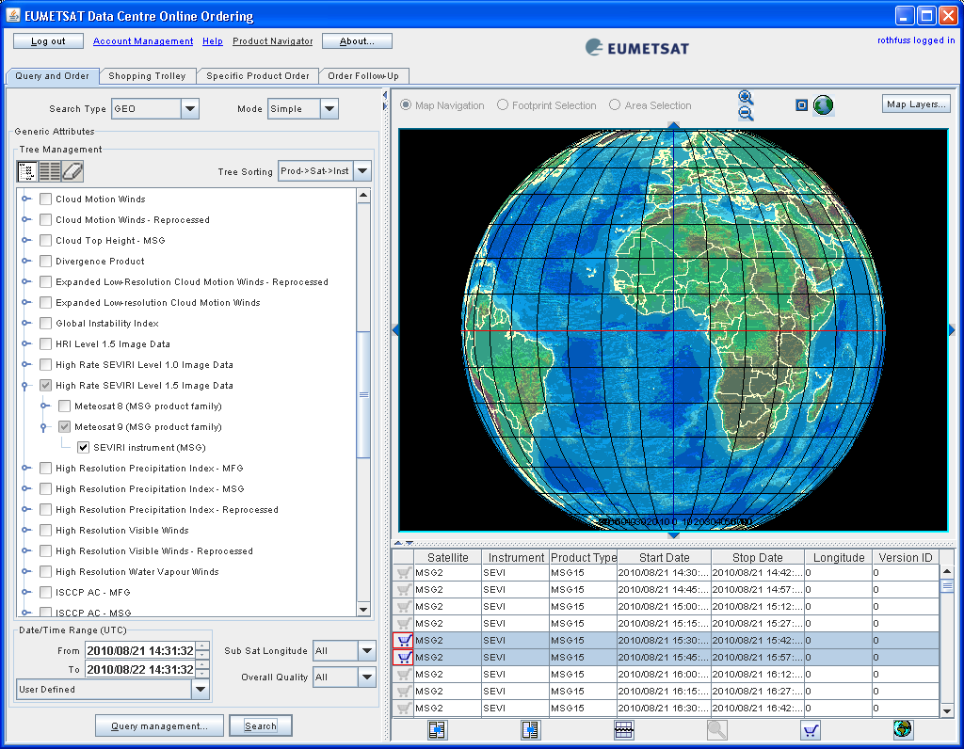
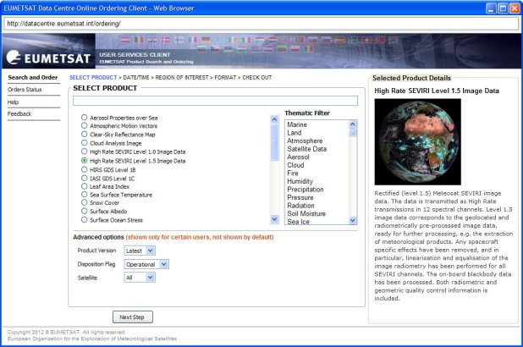
New Data Centre Ordering Client
A new, web browser based ordering client is under development
The aim is to simplify the user interface and make it more intuitive
The current Java-based ordering client will still be
accessible for a period of time, in parallel to the new client
Main enhancements:
The new design will guide users through ordering steps
Enhanced product search
Estimation of number of items selected + order size
Ordering features (e.g. ROI selection, enhanced options) only shown if applicable
old
new

Slide 12
New Data Centre Ordering Client
Beta-testing of the new ordering client is planned for Q3 2014
If you are interested in participating to the beta-testing, please contact our User Service Helpdesk (ops@eumetsat.int)
Operational release expected for Q4 2014

Slide 13
Contents
Overview on current EUMETSAT satellites and future satellite launch plans
Future service enhancements:
New Web Imagery Service
New Data Centre Ordering Client
User Notification Service 2.0

Slide 14
UNS 2.0 – New UNS Web Interface
We have developed a new UNS web interface which will allow users to easily search/filter and display all types of announcements related to operational satellite services
It will be integrated into the Service Status page of our website

Slide 15
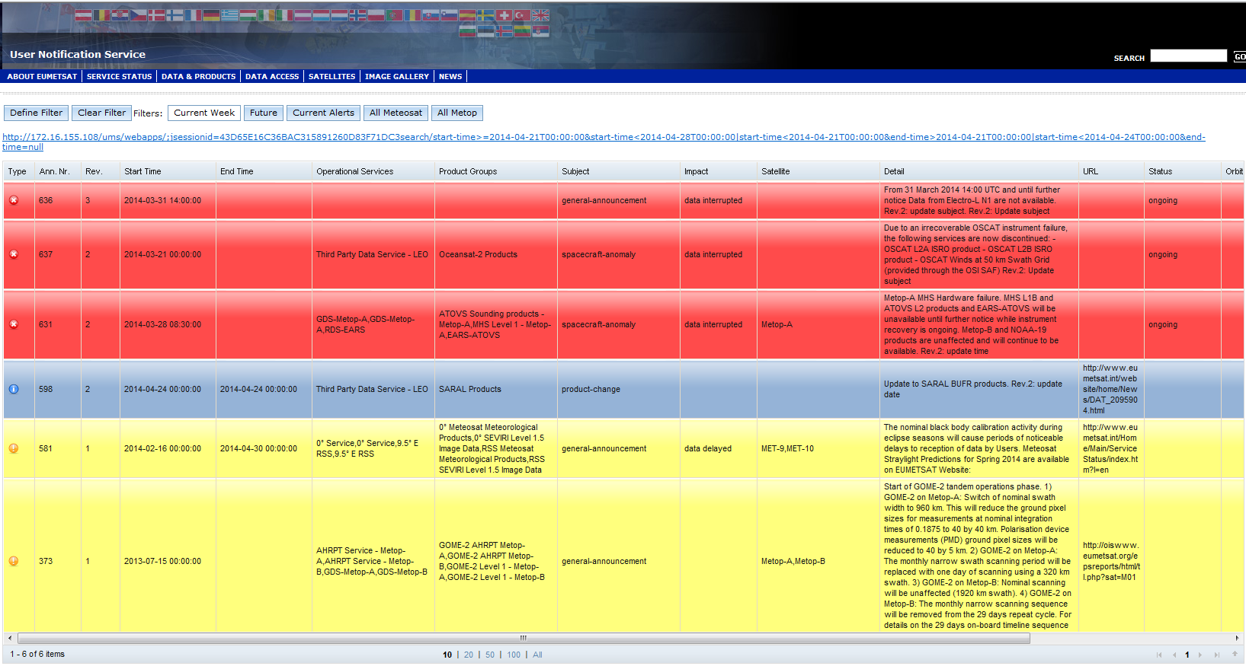
UNS 2.0 – New UNS Web Interface
How it will look like:

Slide 16
UNS 2.0 – New UNS Web Interface
Main features:
Color code used to identify the announcement type:
Planned Maintenance
Service Alert
Service/Product Enhancement
‘Operational Services’ and ‘Product Groups’ follow the terminology of our Operational Services Specification
Impact of event to the service is described as follows:
Data degraded (quality issue)
Data interrupted (definitive outage, intermittent, not disseminated)
Data delayed (delivery issue)
Announcement details are displayed in a pop-up window for each announcement selected

Slide 17
UNS 2.0 – New UNS Web Interface
Possibility of applying filters
Example 1:

Slide 18
UNS 2.0 – New UNS Web Interface
Possibility of applying filters
Example 2:

Slide 19
UNS 2.0 – New UNS Web Interface
Next steps:
Parallel service of UNS 2.0: Q4 2014
Only the planned maintenance and Service/Product enhancement messages will be included initially
This will allow users to get familiar with the new web interface in advance of the switch-over.
Transition of users from existing service to new service
Incorporate Alert messages
Implementation of integrated user registration via the EO Portal for email messages
Update of Service Status page on EUMETSAT website to accommodate the new UNS web interface.
Additional features to be included in future releases of the UNS:
RSS feed
i-calendar integration
Integration with OSSI

Slide 20
UNS 2.0 – Enhancements to the OSSI
OSSI = Operational Service Status Indicator
Web tool providing a visual overview of the current status (availability/timeliness) of operational services.
Notes:
- Updating frequency of OSSI is 5 min for a sliding time-window of 24h for GEO-based services and 12h for LEO-based services.

Slide 21
UNS 2.0 – Enhancements to the OSSI
Future inclusion of the following services in the OSSI:
EUMETCast (by end of the year)
SAFs
Regional Data Service (EARS)
Cross-referencing of OSSI with UNS announcements: planned for 2015.

Slide 22
A few other things...

Slide 23
Product Navigator for Smart Phones
Available since November 2013
Key Features:
Simple search
Scroll through results
View product descriptions
Link to main PN for more details.

Slide 24
Follow us on Twitter!
@eumetsat_users account was started in June 2012 and has now 607 followers.
We tweet imagery, product and service updates and other information which might be of interest to our users.
Our most popular tweets are our Image Library entries.

Slide 25
Your feedback is welcome!
Any feedback that you may have on our services is most welcome!
Just send an email to our User Service Helpdesk: ops@eumetsat.int

Slide 26
Questions / Comments ?

Slide 27
Thank you !

