Slide 1
EUMETCast Europe DVB-S2 Migration

Slide 2
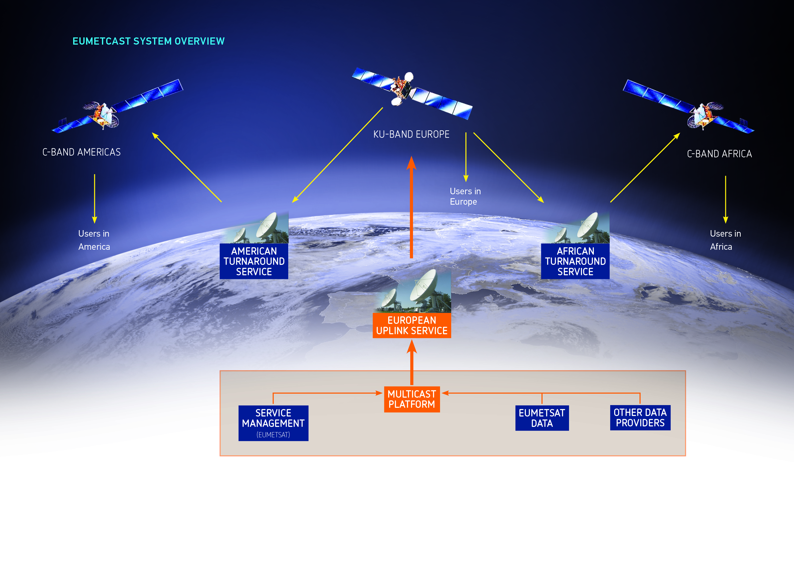
EUMETCast System Overview

Slide 3
Data Rate Evolution in the Past

Slide 4
Future Evolution of Data Rates
transponder limit DVB-S2 High Volume Service
transponder limit DVB-S2 Basic Service
transponder limit
DVB-S

Slide 5
Why Changing to DVB-S2
Currently 20.5 Mbps, scalable up to ~31 Mbps using full transponder;
With the introduction of new programmes and product streams, the dissemination data rates will grow considerably beyond 40 Mbps in the next few years;
The DVB-S2 standard is more efficient at using the satellite resources and allows considerably higher throughput on the transponders compared to DVB-S;

Slide 6
Why Changing to DVB-S2
The achievable DVB-S2 data rates depend on the reception antenna sizes — larger antenna sizes can support higher data rates, this is done by the proper selection of the so called DVB-S2 MODCODs (MODulation and CODing);
For example:
 |  |  |  |  | antenna sizes (m)
 | MODCOD | MS/s | net rate (Mbps) | throughput gain | centre | ... | edge
Current → | DVB-S | 27.5 | 31 | 0%
Basic Service → | 8PSK3/5 | 30 | 47.3 | 53% | 0.72 | ... | 2.40
 | 8PSK2/3 | 30 | 52.6 | 70% | 0.80 | ... | 2.67
 | 8PSK3/4 | 30 | 59.3 | 91% | 0.90 | ... | 3.00
 | 8PSK5/6 | 30 | 63.2 | 104% | 1.00 | ... | 3.33
 | 8PSK9/10 | 30 | 71.2 | 130% | 1.20 | ... | 4.00
High Volume Service → | 16APSK2/3 | 30 | 70.0 | 126% | 1.20 | ... | 4.00
 | 16APSK3/4 | 30 | 78.7 | 154% | 1.50 | ... | 5.00
 | 16APSK4/5 | 30 | 84.1 | 171% | 1.80 | ... | 6.00
 | 16APSK5/6 | 30 | 87.7 | 183% | 2.00 | ... | 6.67

Slide 7
New EUMETCast Europe Communication Satellite
Communication Satellite
Not pre-emptible 36 MHz transponder C4 on EUTELSAT 10A (ex. W2A) at 10°E;
The satellite was launched in 2009 and has an expected lifetime of more than 15 years;
Backup transponder EUTELSAT 15A at 15°E
Footprint see next slide;

Slide 8
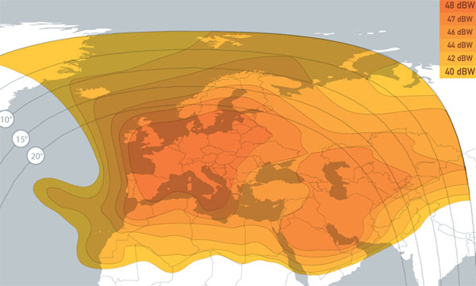
New EUMETCast Europe Footprint
EUTELSAT 10A (10 deg East)

Slide 9
New EUMETCast Europe Transponder
Two transmission plans will be tested during Verification & Validation:
30 MSymbol/s, roll-off 20%, “standard” setting;
33 MSymbol/s, roll-off 5%, allows 10% higher data rates.
An earlier start of a test downlink in June is planned to:
Allow station manufacturers to develop and test compatible devices;
Allow users to make preliminary tests and assess their reception equipment.

Slide 10
New EUMETCast Europe Transponder
Some of these are planning parameters and might change during the validation phase in July 2014;
Ku-band Transponder EUTELSAT 10A (10° E), Europe
Parameter | Value
Name Transponder | EUTELSAT 10A
 | C4
Down Link Frequency | 11263 MHz
Symbol Rate | 33000 kS/s
Polarisation | Horizontal
Roll-Off | 5%
Transmission Standard | DVB-S2
MODCOD 1 — Basic Service | 8PSK3/5 MPE transport stream (TS) ISI=1 max 55 Mbps info bit rate (at TS level) max 50 Mbps IP data rate
MODCOD 2 — High Volume Service | 16APSK2/3 MPE transport stream (TS) ISI=1 max 85 Mbps info bit rate (at TS level) max 77 Mbps IP data rate

Slide 11
Basic Service and High Volume Service Concept
EUMETCast Europe will provide two simultaneous services on the same transponder via DVB-S2:
Basic Service: up to 50 Mbps per transponder
- Continuation of current service with existing antennas
High Volume Service: up to 80 Mbps per transponder
- Requires larger antennas (~ 1.2 m in Darmstadt)
→ Requires compatible reception devices
More see http://www.eumetsat.int/website/home/DataNewsletter/EUMETCast/DAT_2043191.html

Slide 12
Basic Service
The Basic Service will provide the same availability as the current DVB-S service, assuming the existing antennas are being used;
Data rates up to 50 Mbps on one transponder are possible;
Continuation of the current EUMETCast Europe Service;
All current services will be contained in the Basic Service 1:1;
The DVB reception device must be replaced with a compatible DVB-S2 device. For further information see the DVB-S2 Devices section below;
Existing Antenna size recommendations still valid, see below

Slide 13
High Volume Service
The High Volume Service is optimised for higher data rates up to 80 Mbps per transponder;
Availability of 99.98% (average over a year) requires larger antenna sizes (factor 1.8) compared to the Basic Service;
Users keeping the recommended Basic Service antenna sizes will still be able to receive the High Volume Service, but at a reduced availability, e.g. they will have less rain margin;
Service may start already in 2015 with Copernicus Sentinel 3 data or other 3rd party data;
An antenna size plot over the footprint is available, see below

Slide 14
Antenna size plots
Antenna Sizes and Availability for the Basic Service (8PSK3/5) and the High Volume Service (16APSK2/3)
http://www.eumetsat.int/website/wcm/idc/idcplg?IdcService=GET_FILE&dDocName=PDF_EUMETCAST_E10A_ANTENNA&RevisionSelectionMethod=LatestReleased&Rendition=Web

Slide 15
DVB-S2 VCM
VCM (Variable Coding and Modulation) consists of switching between different MODCODs down to packet level;
VCM allows support for multiple MODCODs within the same carrier. This means that both the High Volume and the Basic Services (described above) can be transmitted simultaneously on the same carrier without interfering with each other;
The reception system will only see the MODCOD with positive link margin, i.e. under bad weather conditions the basic service will be available longer than the High Volume Service as the link degrades;
Users with very small antennas can receive the Basic Service, and users with large antennas can receive both services;

Slide 16
DVB-S2 VCM - continued
More technical info about the benefits and features of DVB-S2:
http://www.incospec.com/resources/downloads/CTID2010/Files/DVB-S2%20at%20Incospec%20Seminar.pdf

Slide 17
Reception Devices Generic Requirements
Standard: DVB-S2;
Symbol Rate: up to 33 MSps;
Support for QPSK, 8PSK & 16APSK including all defined FEC codes for these modulations;
Support for VCM, Multiple Transport Streams, MPE encapsulation;
Support for a minimum of 6 PIDs for the Basic Service and a minimum of 4 PIDs for the High Volume Service, maximum of 8 PIDs for one transponder (both services together);
A maximum output IP bandwidth of 50Mbit/s for the Basic Service and up to 80Mbit/s for the High Volume Service must be supported;

Slide 18
EUMETCast Europe compatible devices
A compatibility test of DVB-S2 devices was performed using a laboratory environment (Ayecka, NewTec, Novra, and other);
Ayecka, NewTec and Novra devices full compatible with DVB-S and DVB-S2;
All devices ready to simultaneously receive Basic and High Volume Service;
Other devices had compatibility problems, which may be resolved once the test signal is available in June;
EUMETSAT encourages industry to provide devices which will support the DVB-S2 EUMETCast broadcast system;

Slide 19
Recommended Reception Devices
Company Name | Model | Type | OS Support | Further information by Company | EUMETCast Setup Information | Used by EUMETSAT
Ayecka | Ayecka SR1 | Router/LAN | All | Ayecka SR1 Satellite Receiver | SR1 Setup Guide | yes
Newtec | EL940 IP Satellite Receiver | Router/LAN | All | Newtec EL940 IP Satellite Receiver | EL940 Setup Guide | yes
Newtec | MDM6000 (successor of EL940) | Router/LAN | All | Newtec MDM6000 Satellite Modem | under construction | planned
Novra | Novra S300E or S300N | Router/LAN | All | Novra S300E Satellite Receiver | S300 Setup Guide | yes

Slide 20
EUMETCast Software
Existing client licenses remain valid;
Tellicast server version (2.12) and client versions (2.4) unchanged;
New client version (2.12) with new functionality and better performance is in test, and will be available Q4 2014/ Q1 2015;

Slide 21
Status of DVB-S2 migration on the WEB
The DVB-S2 WEB page is being frequently updated with latest information:
Availability plots added;
DVB devices setup guides for current service added;
FAQ updated.
All information available on
http://www.eumetsat.int/website/home/TechnicalBulletins/EUMETCast/DAT_2082113.html

Slide 22
New Service V&V and Pilot Users
The goal of the V&V phase in July is to test and then declare operational readiness;
Pilot users will be involved to evaluate the real reception conditions across the footprint and to help decide which transmission plan will be operationally used (30 MSym/s or 33 MSym/s);
We only need to collect statistics from the DVB receiver, no Tellicast running;

Slide 23
Migration: the user side – when to upgrade
The upgrade is mandatory;
There is time until end of 2014;

Slide 24
Migration: the user side – upgrading receiver
Procure DVB-S2 devices;
For DVB routers: Procure and install additional “multicast traffic” network card, if a dedicated NIC is not available in the station;
Select appropriate network design (e.g. EUMETSAT DVB setup guides);
Configure DVB-S2 device for current DVB-S service;
Test and checkout the station on the current service;
Make upgraded stations operational on the current service.

Slide 25
Migration: the user side - Preparing the frontend
Wait until DVB-S2 downlink is available (around June 2014);
Re-pointing is initially not needed for antennas smaller than 1.5 m (or even larger antennas), since E10A is very close to E9A;
A signal splitter cannot be used to receive both services from the same LNB port. The downlink of E9A in in High Band (22KHz on), but the signal of E10A is in Low Band (22 kHz off);
Each DVB receiver requires a dedicated antenna port for exclusive use;
Only if simultaneous reception of old and new service from one antenna is not needed, a single LNB is sufficient;
Dual and Quad LNBs, and multi-switch solutions are ready to support multiple transponders on the same satellite, in all bands on all polarisations;

Slide 26
Migration: the user side - testing reception
Download the latest DVB configuration from the EUMETSAT WEB page for your device (will be updated);
Make sure the DVB device is directly connected to the LNB or a multi-switch device;
Change DVB device to the DVB-S2 values (updated guide);
Evaluate if antenna needs re-pointing.
Note
During the parallel phase the old EUMETCAST stream and the Basic Service on DVB-S2 will be identical. The order of received files or delays might be different. The data stream on the old system will generally be a few seconds delayed.

Slide 27
Migration: the user side – making the switch
On redundant systems, make the switch on the backup system, by updating the DVB router (change profile, load configuration, change it manually);
The DVB routers will lock to the new transponder within seconds, sometimes within few minutes;
Large antennas may need to be re-pointed;
If in doubt that the new system is less robust, keep your system in this configuration for a few days;
Switch the prime system to the new transponder.
Note:
there is no need to consider a switch back to the old system once the new system is declared operational after August. DVB-S will end in December.

Slide 28
High Volume service and multi transponder
Server side
Organisation of the new EUMETCast services on the sending side:
Tellicast server process 1: Basic Service (identical to current service);
Tellicast server process 2: High volume service;
Tellicast server process 3: EUMETCast terrestrial;
Tellicast server process 4: ... (next transponder);

Slide 29
High Volume service and multi transponder
User side
Each Service has its own announcement channel; Choices are:
One physical station (PC) per service (requires multiple software licenses/EKUs);
One PC for multiple services, start multiple Tellicast client processes;
EUMETSAT will provide details early enough before High Volume service will be started.
Addition of services are scalable by adding dedicated stations, or upgrading hardware.

Slide 30
Timeline
Until June 2014: Implementation of System, update of information for users – antenna sizes, equipment, timeline
June 2014: Downlink Switch-On
July 2014: Service validation with pilot users
Begin of August 2014: Start of operational Basic Service and Test High Volume Service
October 2014: Migration of C-Band Africa/Americas to DVB-S2 feed
31 December 2014: End of current DVB-S service
2015 or later: Start of operational High Volume Service

Slide 31
June – July 2014: test and validation
Direct Data Providers (DPs)
Service Provider, Usingen
EUTELSAT 9A
Direct Data Providers:
DWD, RETIM, UKMO, SAFs, EARS, other
Multicast Platform
DVB-S
EUTELSAT 5West A
multicast
EUMETSAT
Uplink
Europe Users
DVB-S
Ground Segments
Africa Turnaround
Africa Users
EXGATE
SES-6
ftp
OIS
DVB-S
External Data Providers:
DWD, Meteo France, ECMWF, NOAA, UKMO, SAFs, EARS, other
EUTELSAT 10A
Americas Turnaround
Service Provider, TBD
MMDS
DVB-S2
Americas Users
Multicast Platform
multicast
Uplink

Slide 32
October 2014: migration of C-band turnaround
Direct Data Providers (DPs)
Service Provider, Usingen
EUTELSAT 9A
Direct Data Providers:
DWD, RETIM, UKMO, SAFs, EARS, other
Multicast Platform
DVB-S
multicast
EUTELSAT 5West A
EUMETSAT
Uplink
Europe Users
DVB-S
Ground Segments
Africa Turnaround
Africa Users
EXGATE
SES-6
ftp
OIS
DVB-S
External Data Providers:
DWD, Meteo France, ECMWF, NOAA, UKMO, SAFs, EARS, other
EUTELSAT 10A
Americas Turnaround
Service Provider, TBD
MMDS
DVB-S2
Americas Users
Multicast Platform
multicast
Uplink

Slide 33
1 January 2015: end of Ku band DVB-S
Direct Data Providers (DPs)
Service Provider, Usingen
EUTELSAT 9A
Direct Data Providers:
DWD, RETIM, UKMO, SAFs, EARS, other
Multicast Platform
multicast
EUTELSAT 5West A
EUMETSAT
Uplink
Europe Users
DVB-S
Ground Segments
Africa Turnaround
Africa Users
eEdge
SES-6
ftp
IDS
DVB-S
External Data Providers:
DWD, Meteo France, ECMWF, NOAA, UKMO, SAFs, EARS, other
EUTELSAT 10A
Americas Turnaround
Service Provider, TBD
MMDS
DVB-S2
Americas Users
Multicast Platform
multicast
Uplink

Slide 34
“any questions”.

