Slide 1
Science from Meteorological Satellites: MSG to MetOp
Neil Humpage
Earth Observation Science
University of Leicester

Slide 2
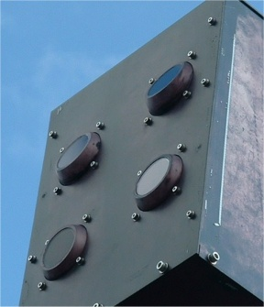
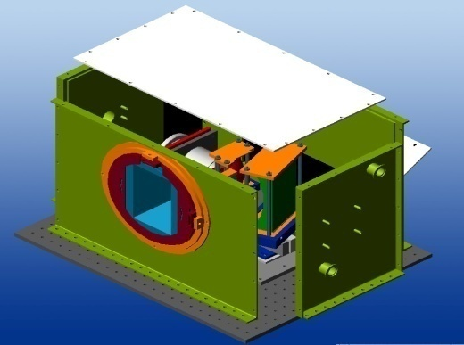
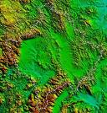
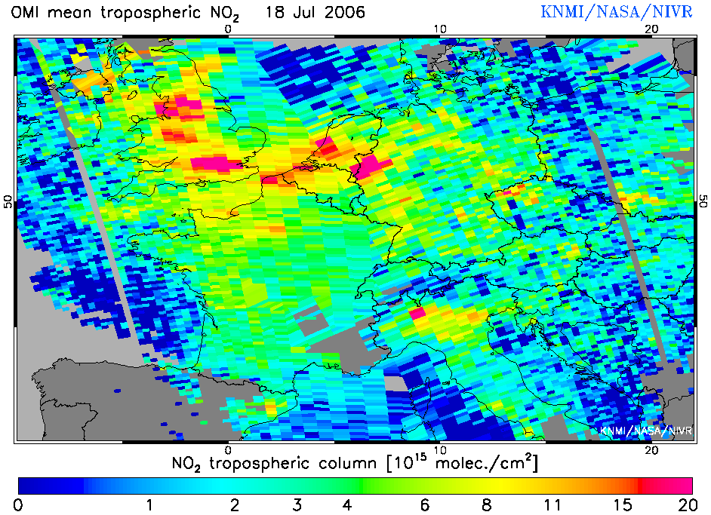
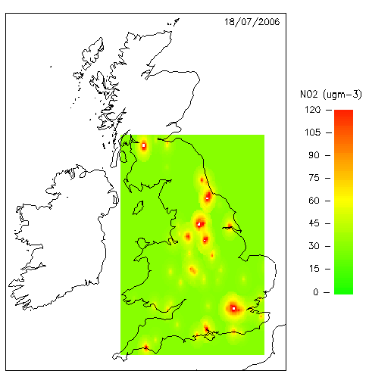
EOS at Leicester
Core goal: To design, build and exploit increasingly powerful satellite sensors to address critical questions concerning the Earth’s atmosphere and surface.
Multidisciplinary: The group links researchers in Physics, Chemistry and Geography.
Key areas: Atmosphere composition; climate processes and trends; surface temperature; vegetation and fires; integrated observing systems of satellites, ground and aircraft based instruments.

Slide 3
Overview
Some themes in which Earth Observation Science at the University of Leicester is thriving:
Sea and land surface temperature
Measurement of atmospheric trace gases and aerosols
Monitoring of air quality from space, the ground and the air
Mapping of greenhouse gas concentrations

Slide 4
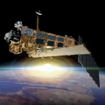
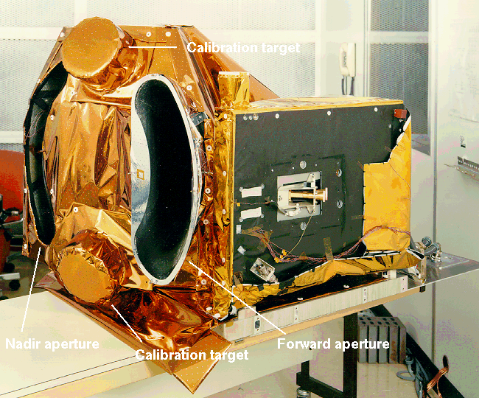
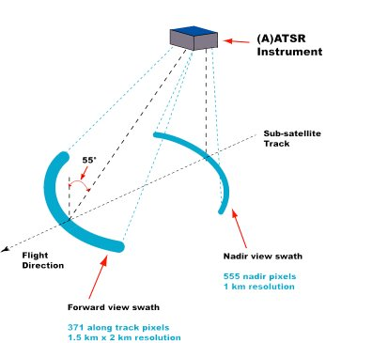
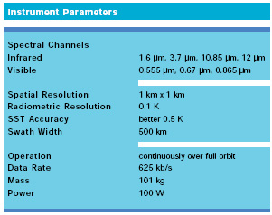
(A)ATSR
(Advanced) Along Track Scanning Radiometer
Series of instruments designed primarily to measure sea surface temperature (SST)
ATSR-1 on board ERS-1: July 1991 to March 2000
ATSR-2 on board ERS-2: April 1995 to September 2011
AATSR on board ENVISAT: March 2002 to April 2012
Four infrared channels
Extra visible channels in ATSR-2 and AATSR for vegetation monitoring and land surface temperature measurements
Dual viewing geometry allows for atmospheric correction
Single channel accuracy ± 0.05 K with on-board calibration

Slide 5
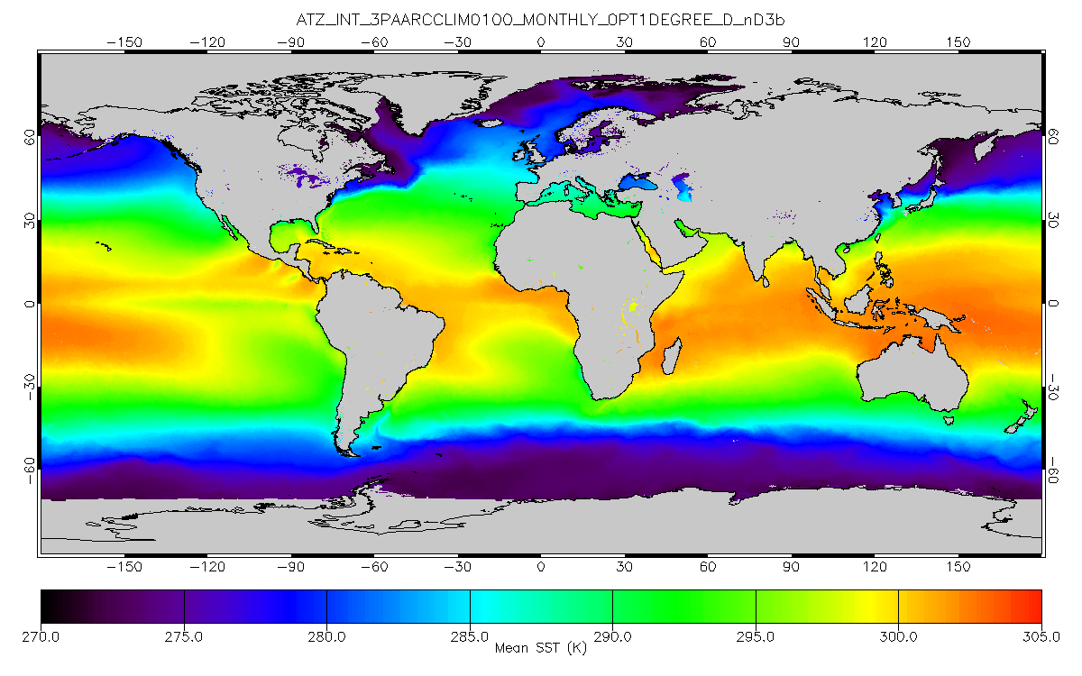
SST with ATSR
ATSR Reanalysis for Climate (ARC) SST climatology (1997-2011) : night-time, dual-view, 3-channel retrieval
Dr Karen Veal

Slide 6
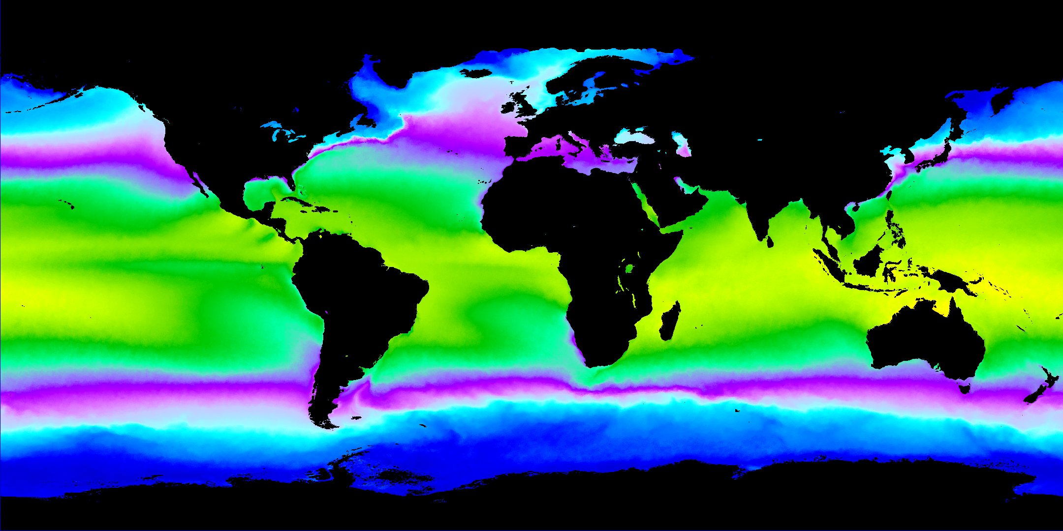
SST with ATSR
ATSR Version 2.0 monthly SST climatology for 1997-2011: night-time, dual-view, 3-channel retrieval.
Dr Karen Veal

Slide 7
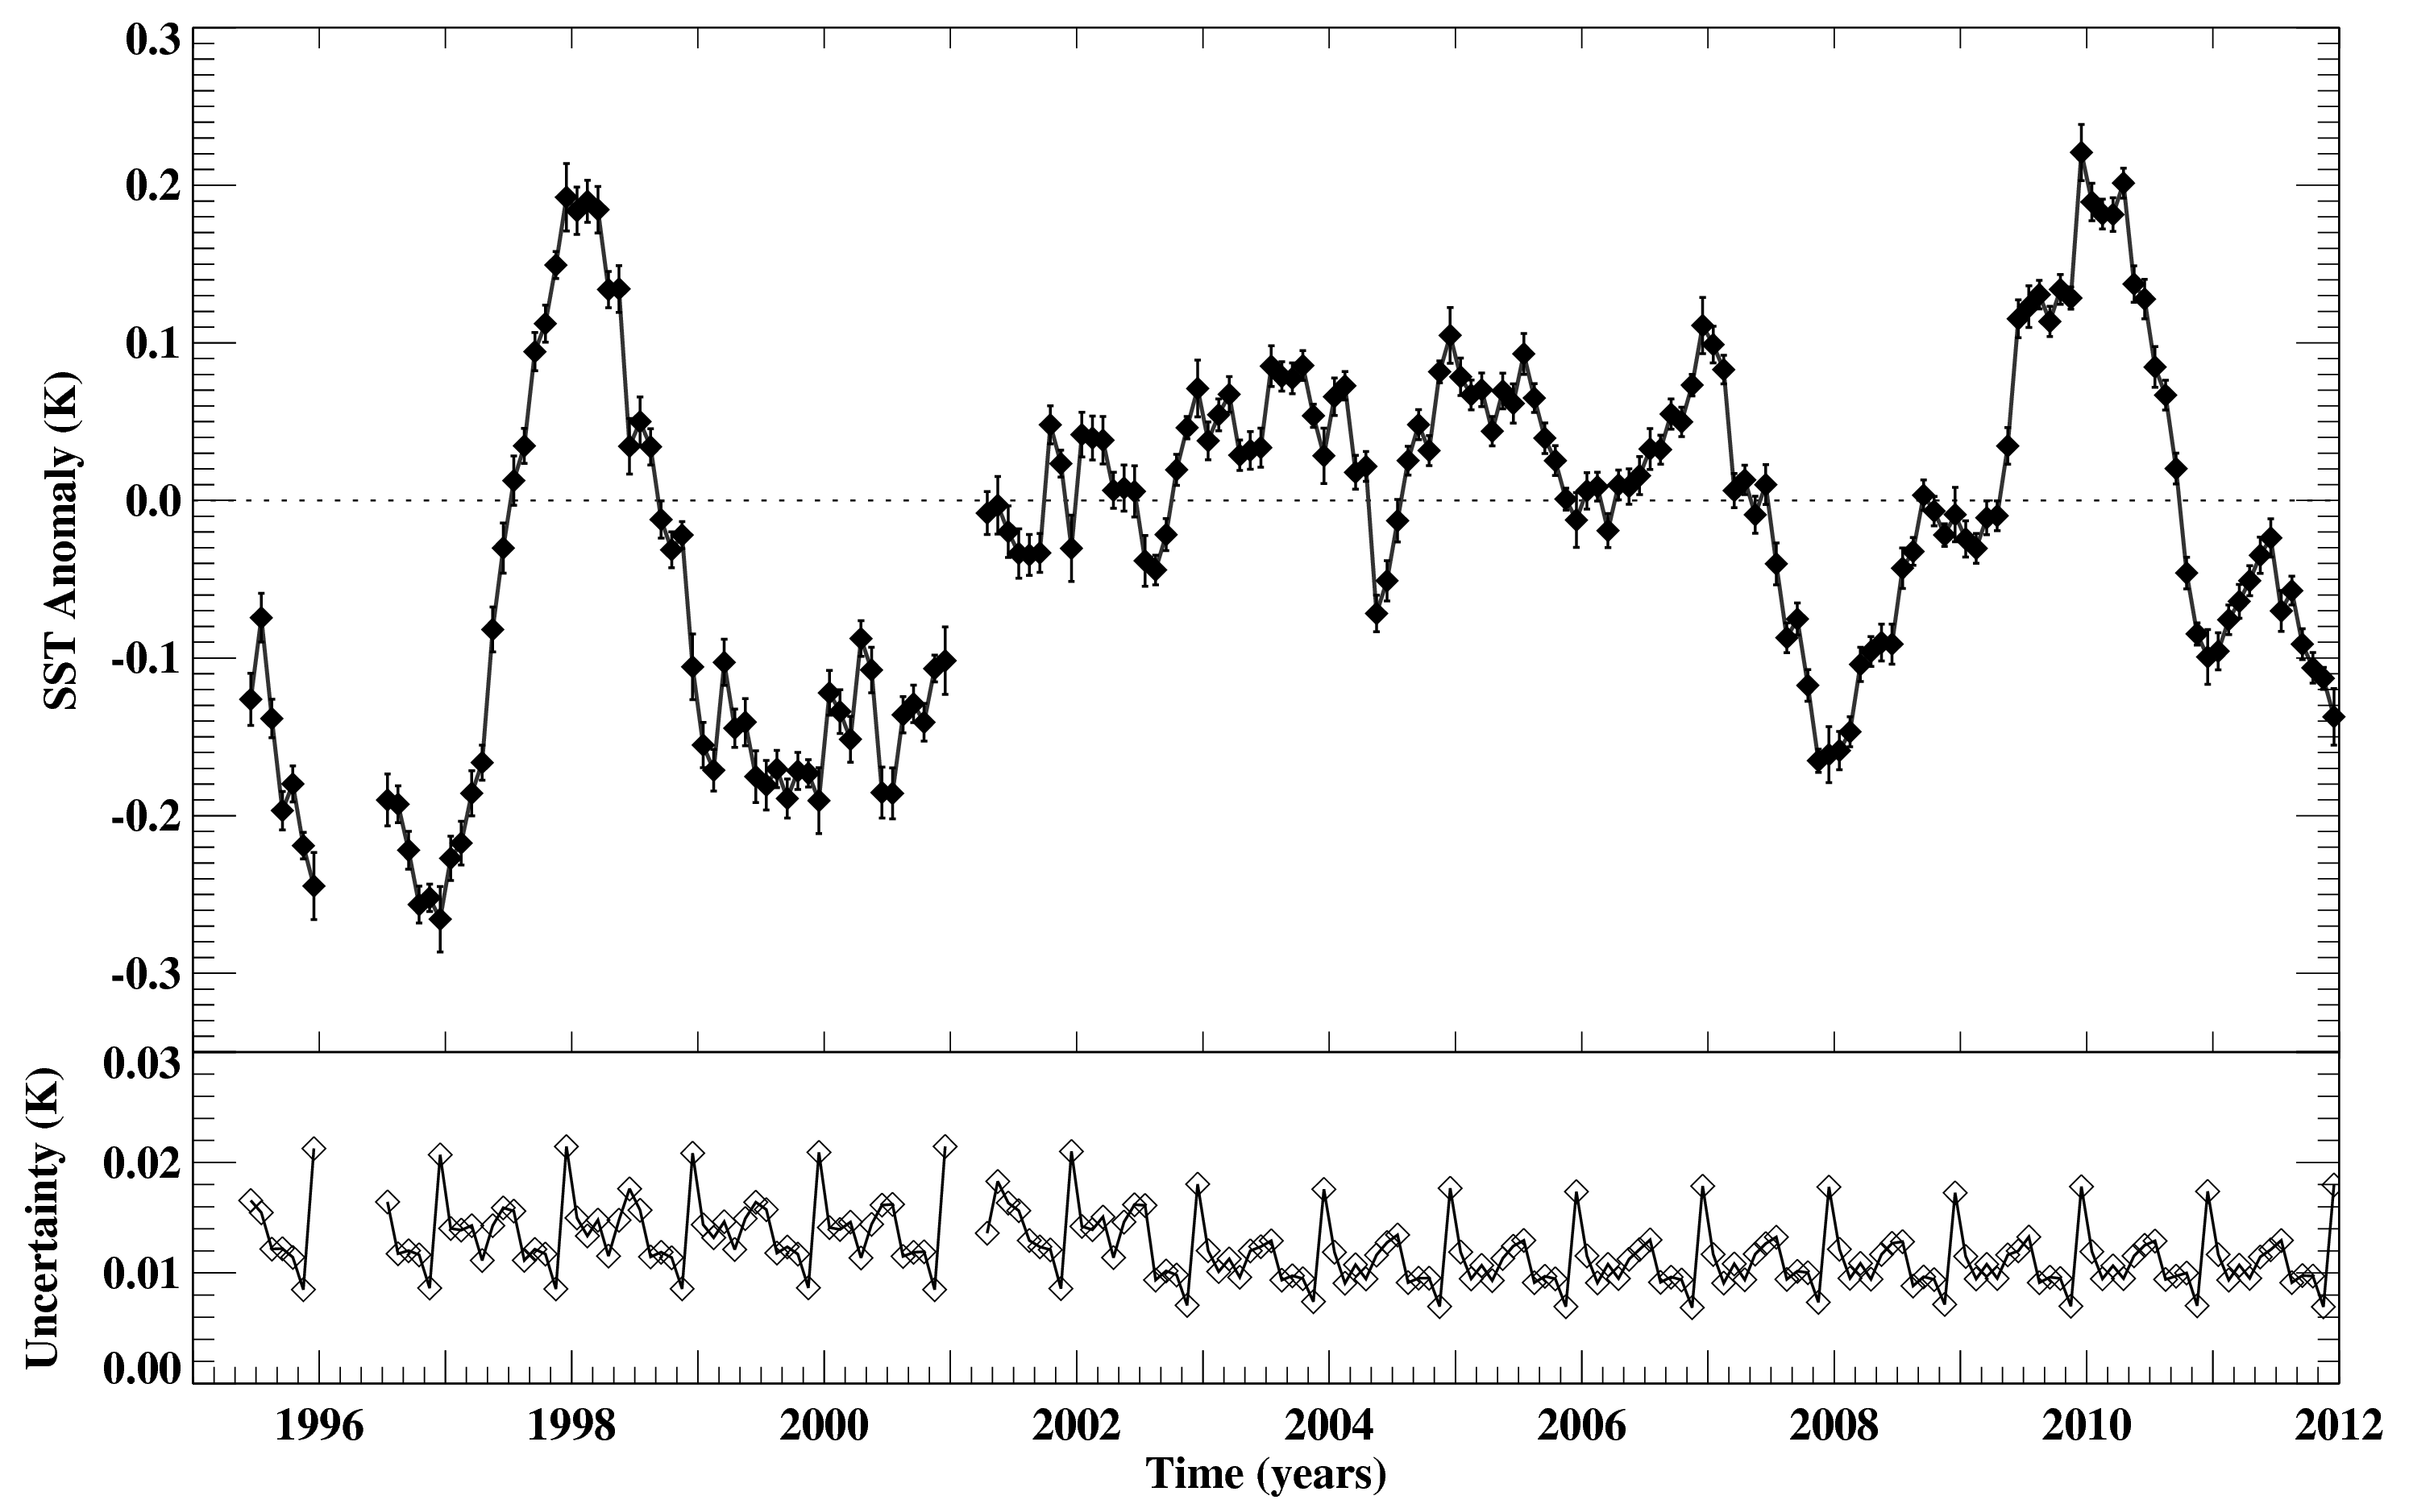
SST Anomaly with ATSR
ATSR V2.0 global SST anomaly (to ATSR climatology for 1997-2011) : night-time dual-view 3-channel retrieval
Dr Karen Veal

Slide 8
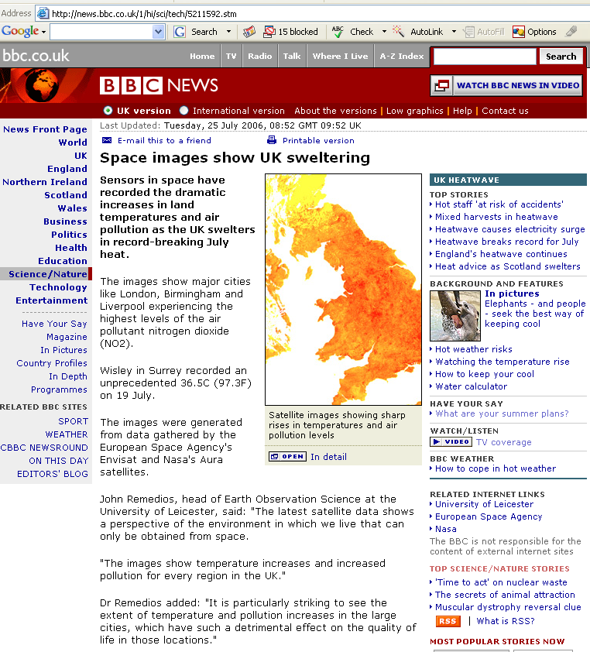
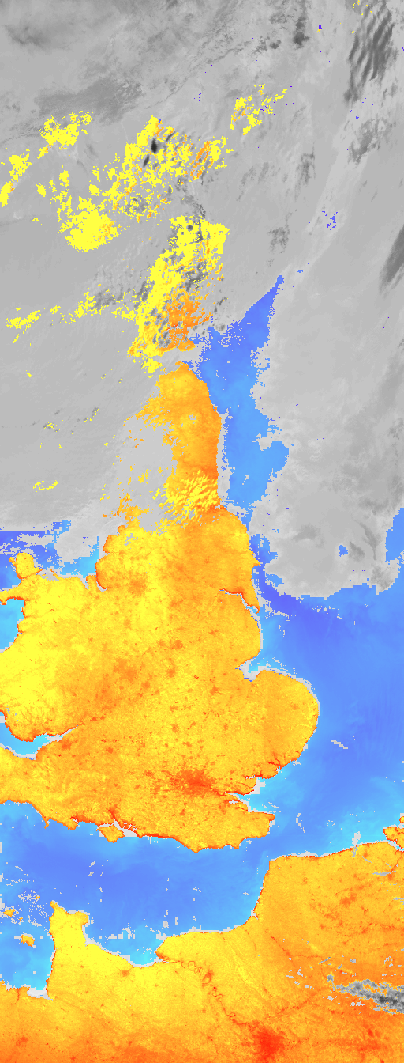
ATSR on a UK scale: land surface temperature

Slide 9
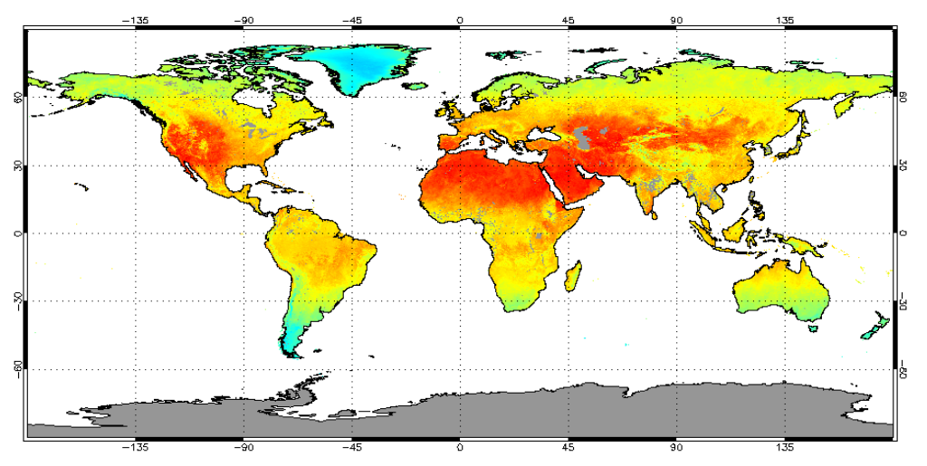
GlobTemperature (ESA)
Develop a merged LST data set from thermal infrared (geostationary & polar orbiter) and passive microwave satellite data to provide best possible coverage, including information on the diurnal cycle and clear-sky bias
Develop a prototype LST climate data record from (A)ATSR
Provide users with a single point of access to multi-mission satellite land, lake and ice surface temperature data sets in a harmonised format, including consistently generated uncertainty budgets, documentation, and quality information obtained through intensive intercomparison and validation
Dr Darren Ghent

Slide 11
Atmosphere theme
Short-lived key species control greenhouse gas lifetime, air quality and tropospheric ozone and provide information on atmospheric climate-chemistry and convection processes; their land surface emissions (biogenic, pyrogenic, volcanic eruptions) are important in coupling land surface and atmosphere Earth System Models.
Determination of key volatile organic compounds (VOCs) and volcanic ash signatures from infrared satellites
Global retrievals of PAN, acetone, HCOOH, C₂H₂ and C₂H₆ in the upper troposphere from MIPAS and development of global tropospheric CO, HCOOH and C₂H₂ products from IASI
Comparison to chemical transport models of VOCs – collaboration with NCEO-Leeds and NCEO-Edinburgh
Support for NERC-funded aircraft campaigns (i.e. BORTAS)
CEMS demonstrator for near-real time capability.

Slide 12
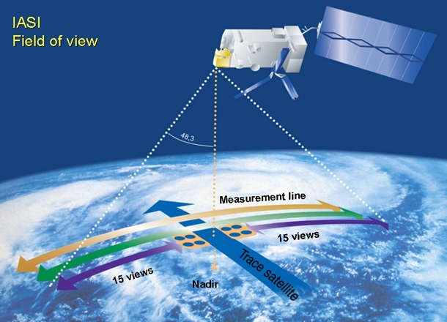
METOP-IASI
IASI specifics
Platform | METOP
Instrument type | Michelson Interferometer
Mass | 210 kg
Spectral range | 3.62 to 15.5 microns (645-2760 cm⁻¹)
Spectral resolution | 0.5cm⁻¹
Species measured | L1C emission spectra L2 vertical profiles- operational products: CO₂, N₂O, CFC-11, CFC-12, OCS, H₂O, O₃,CH₄, NH₃, CO, HNO₃, HCOOH, CH₃OH, SO₂
IASI
Infrared Atmospheric Sounding Interferometer
MetOp-A launched 2006
MetOp-B launched 2012
12km resolution at nadir
2112km swath width

Slide 13
Detection approach – brightness temperature differencing (BTD)
Cloud-free IASI Brightness Temperature spectrum
Use clear gas lines (“peak”) which are largely free from contaminating species.
HCOOH 1105 cm⁻¹
HCN 747.5 cm⁻¹
C₂H₂ 766.75 cm⁻¹
C₂H₄ 949.5 cm⁻¹
Find “baseline” regions either side of peak which is relatively clear of target gas AND with little influence of other highly variable gases (i.e. another biomass marker)
Dr David Moore

Slide 14
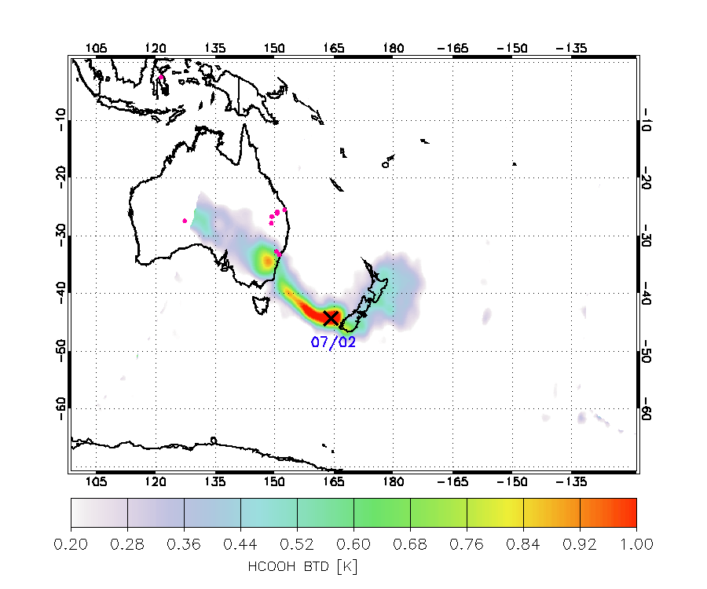
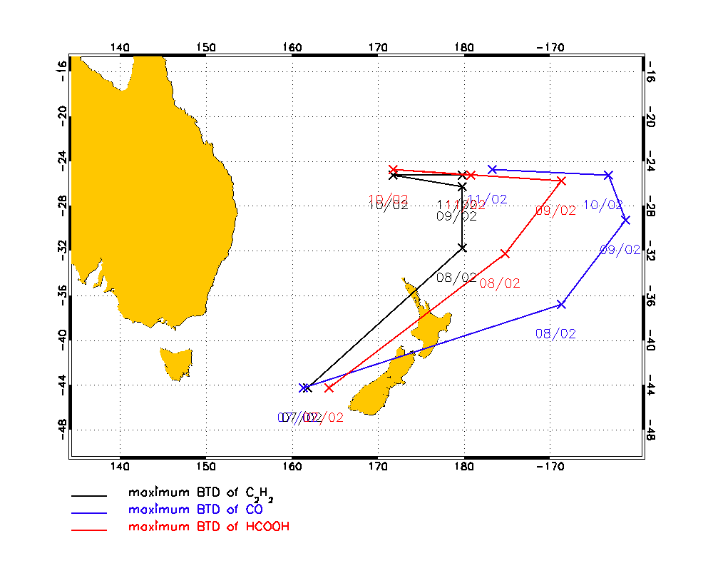
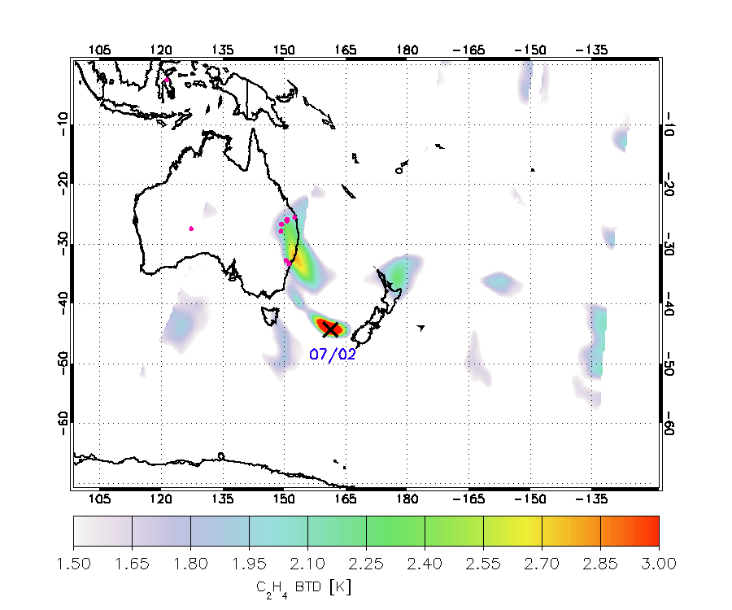
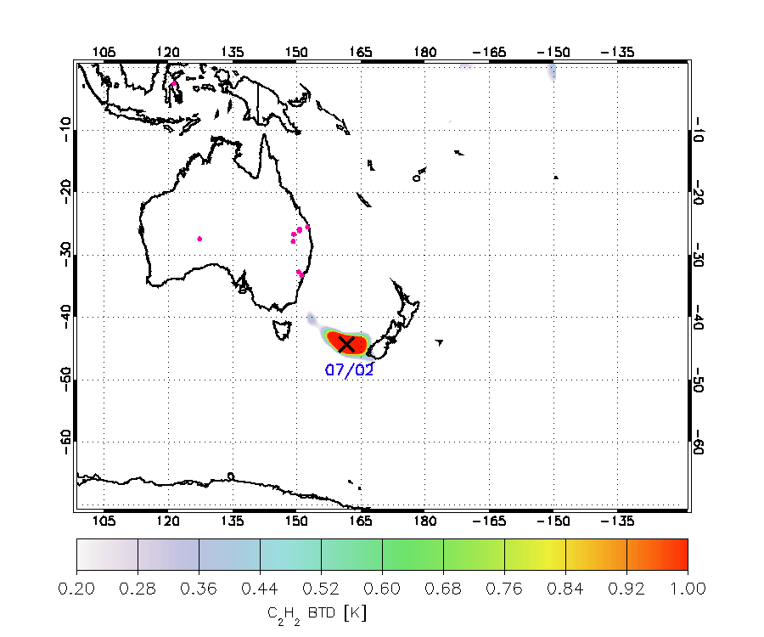
Following plume tracks with IASI
CO
HCOOH
C₂H₄
C₂H₂
Dr David Moore

Slide 15
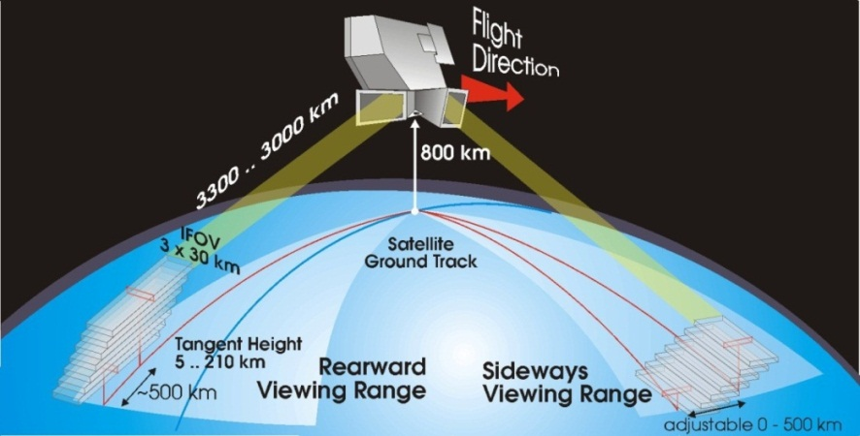
ENVISAT-MIPAS
MIPAS specifics
Platform | ENVISAT
Instrument type | Fourier Transform Spectrometer
Mass | 320 kg
Spectral range | 4.15 to 14.2 microns in 5 spectral bands (685-2410 cm⁻¹)
Spectral resolution | 0.025cm⁻¹ (March 2002-March 2004) 0.0625 cm⁻¹ (August 2004-April 2012)
Vertical range | 6 to 68 km
Vertical resolution | 3 km from 6 to 42 km, 5 km from 42 to 52 km, 8 km from 52 to 68 km
Species measured | L1b emission spectra - Potential to observe many gases L2 vertical profiles- operational products: H₂O, O₃,CH₄, N₂O, NO₂, HNO₃
MIPAS
Michelson Interferometer for Passive Atmospheric Sounding
Envisat launched 2002 with 10 instruments on board
Contact lost April 2012
Limb viewing geometry provides much longer absorption path length than nadir → greater sensitivity to trace gases

Slide 16
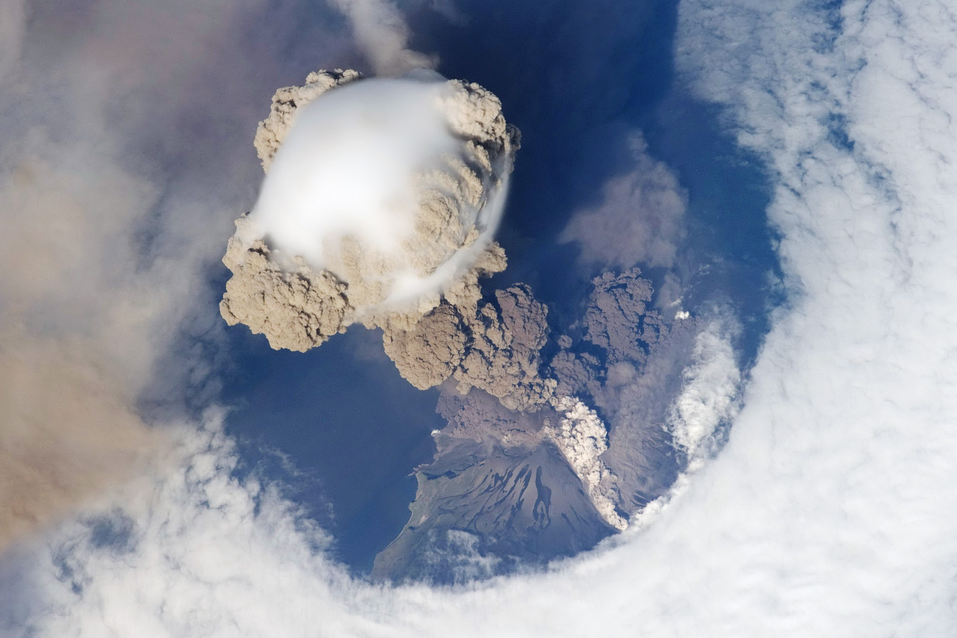
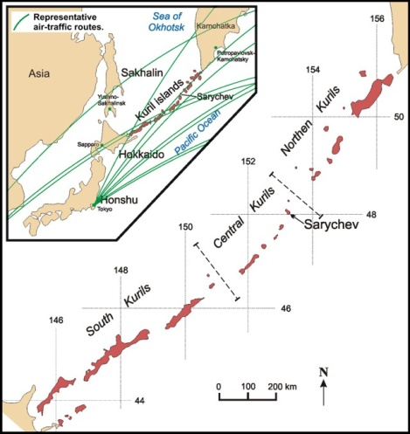
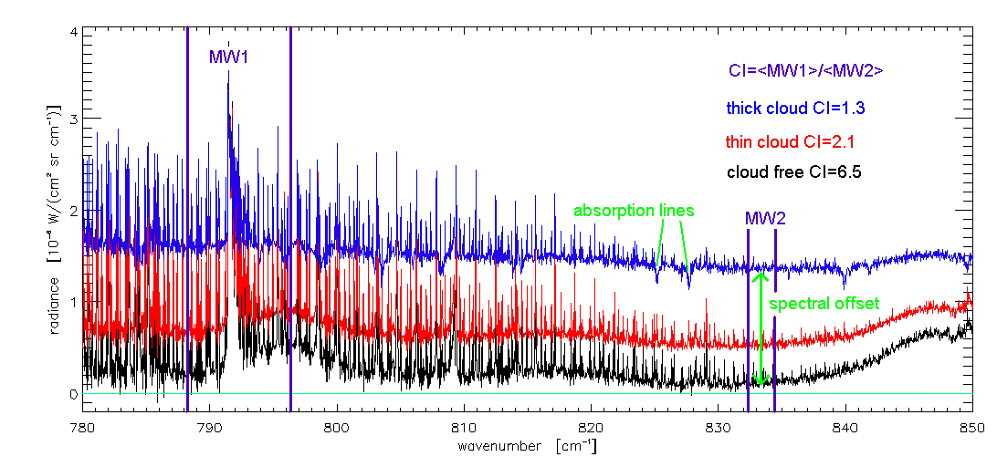
MIPAS volcanic observations: Sarychev Peak
Sarychev Peak volcano located at 48ºN, 153ºE on the Kuril Islands, northeast of Japan
Series of explosions occurred from 12th to 17th June 2009, injecting 1.2 ±0.2Tg of sulphur dioxide (SO2) into the upper troposphere and lower stratosphere (UTLS)
Ash cloud injection estimated at altitudes ~ 8 to 16 km possibly reaching as high as 21 km
Clouds and aerosols in the MIPAS line of sight cause a strong spectral radiance offset due to enhanced continuum emission (often accompanied by a dampening of trace gas features)
These cloud effects can be quantified by the Cloud Index (CI): a threshold-based colour ratio method that exploits the 12 μm sensitivity to clouds and aerosol
Dr Harjinder Sembhi

Slide 17
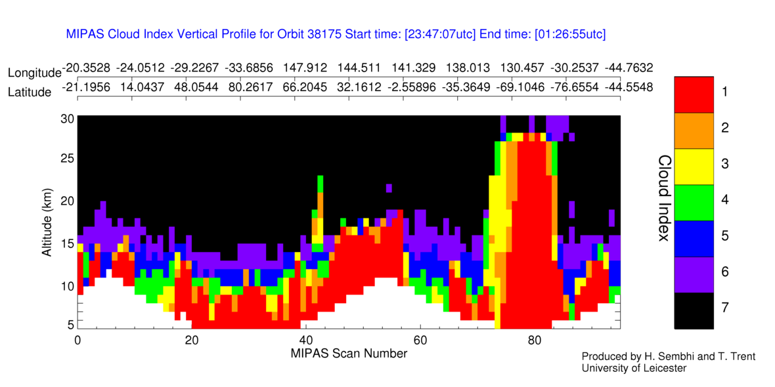
MIPAS volcanic observations: Sarychev Peak
Cloud and aerosol detection method based on spectral sensitivity of particles in the MIPAS spectra
Colour ratio of cloud/aerosol and control spectral region (Spang et al., 2012, ACP, Sembhi et al., 2012, AMTD)
Eruption in MIPAS Cloud Index (CI) on 17th June 2009
Volcanic particles up to 22 km
Sarychev
Dr Harjinder Sembhi

Slide 18
Layers of H₂SO₄ measured with MIPAS
June
July
Compares relatively well with HADGEM2 model total column sulphate aerosol calculations in
Haywood et al., 2010
Dr David Moore

Slide 19
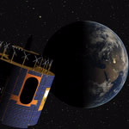
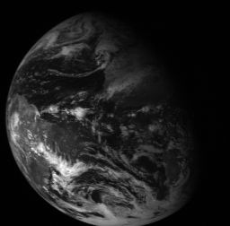
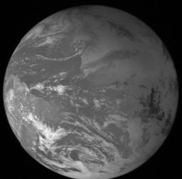
Meteosat Second Generation
In geostationary orbit 36,000 km above the equator, the Meteosat satellites — Meteosat-7, -8, -9 and -10 — operate over Europe and Africa
Meteosat-10 (launched from the Guiana Space Centre in Kourou in 2012) is the prime operational geostationary satellite, positioned at 0 degrees and providing full disc imagery every 15 minutes
Meteosat-9 (launched in 2005) provides the Rapid Scanning Service, delivering more frequent images every five minutes over parts of Europe, Africa and adjacent seas
Meteosat-8 (launched in 2002) serves as a back up to both spacecraft. Meteosat-7 (launched in 1997) is the last of the first generation of Meteosat satellites and operates over the Indian Ocean, filling a data gap over the region until it is de-orbited in 2017

Slide 20
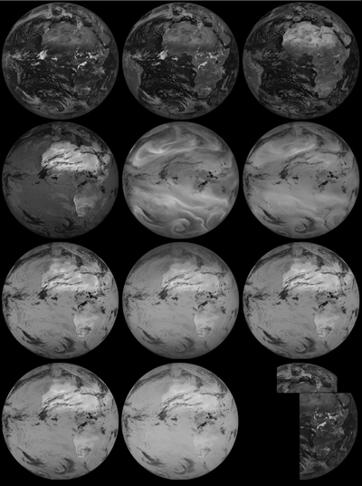
MSG-SEVIRI
Spinning Enhanced Visible and Infrared Imager
12 spectral channels:
8 thermal infrared channels
3 solar channels
1 broadband high resolution visible channel (1km compared with 3km spatial sampling)
Used primarily for weather monitoring and forecasting
Multiple spectral channels enable improved vertical profiling of the atmosphere → improved quality of starting conditions for numerical weather prediction (NWP)

Slide 21
CEMS near-real time demonstrator – Detecting volcanic ash from space
2010 Iceland event
Images available at up to 5 minute intervals from SEVIRI Rapid-Scan service
Applications of NRT service:
Volcanic eruption monitoring
Storm events + other weather events
Educational outreach activities (schools)
Key
Volcanic ash Thick Cloud Warm surface
Dr David Moore

Slide 22
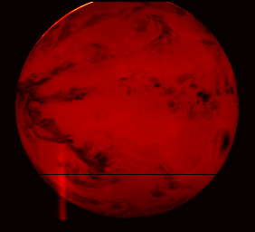
MSG-GERB
Geostationary Earth Radiation Budget
2 broadband channels:
Visible: 0.32 to 4.0 microns
‘Total’: 0.32 to 30 microns
Difference between channels provides thermal radiation: 4.0 to 30 microns
On-board calibration with 1% accuracy
Radiation budget represents difference between the incoming solar radiation, and the sum of the reflected visible and emitted thermal radiation as measured by GERB
Used in climate monitoring and NWP

Slide 23
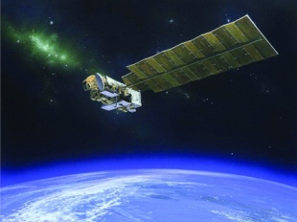
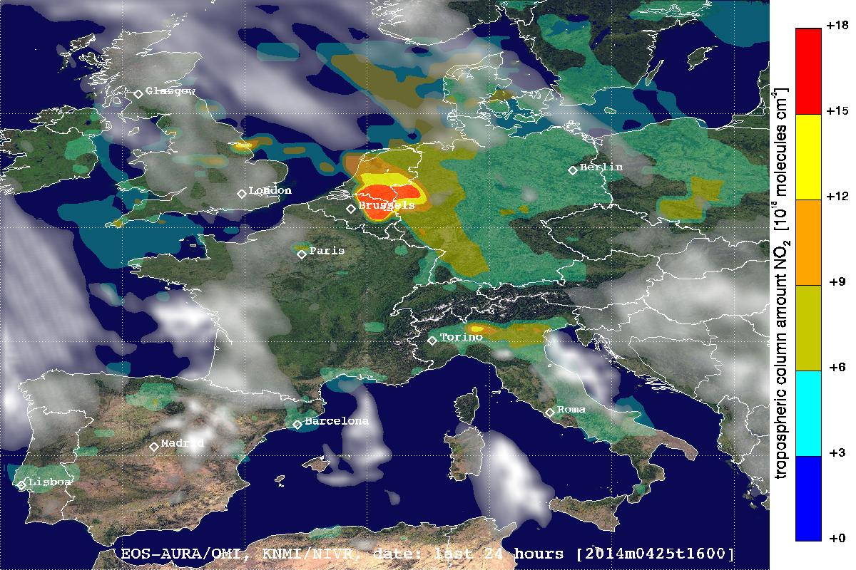
Monitoring air quality: OMI
Ozone Monitoring Instrument
On board NASA-AURA
Nadir viewing imaging spectrograph
270 – 500 nm (backscattered solar radiation)
2600 km swath → daily global coverage
13km x 24km spatial resolution
NO₂ key gas for air pollution

Slide 24
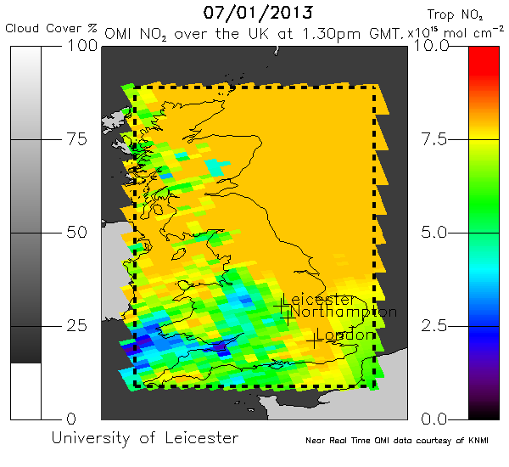
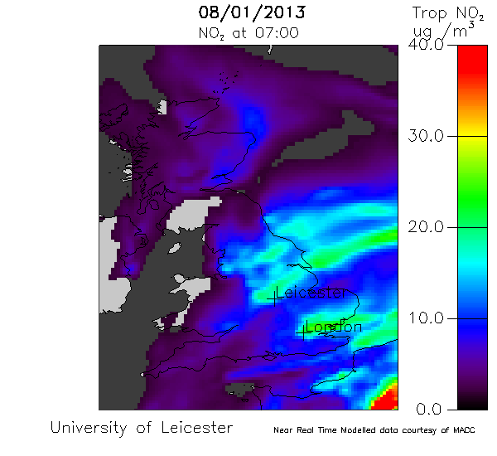
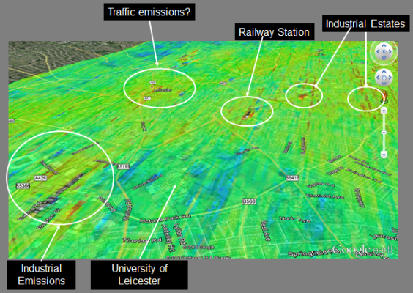
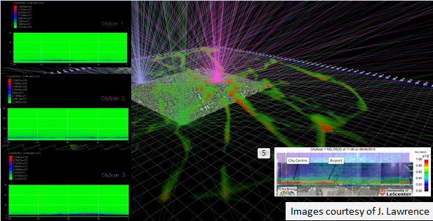
NO₂: Applications and Services
OMI + Successors
MACC
Improved air quality. Reduced human exposure.
Background Field
Guidance to urban management systems
Static Emission Sources
Vehicle Emission validation
Air Quality model
Airborne DOAS mapping
Modelling with photon path calculations
Emissions, Dynamics
CityScan
Dr Roland Leigh and Dr James Lawrence

Slide 25
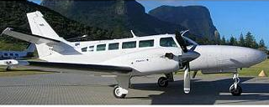
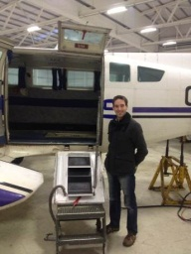
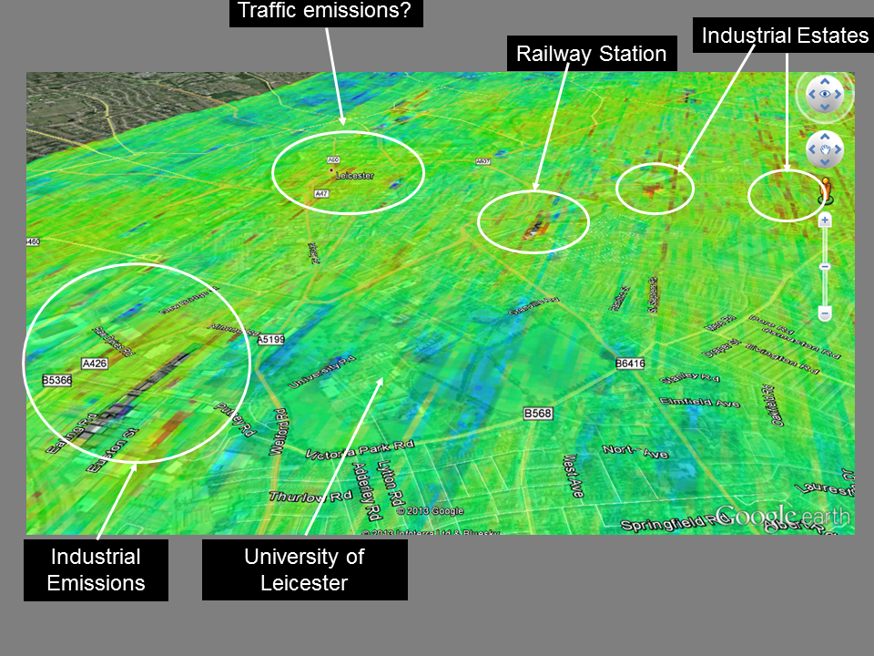
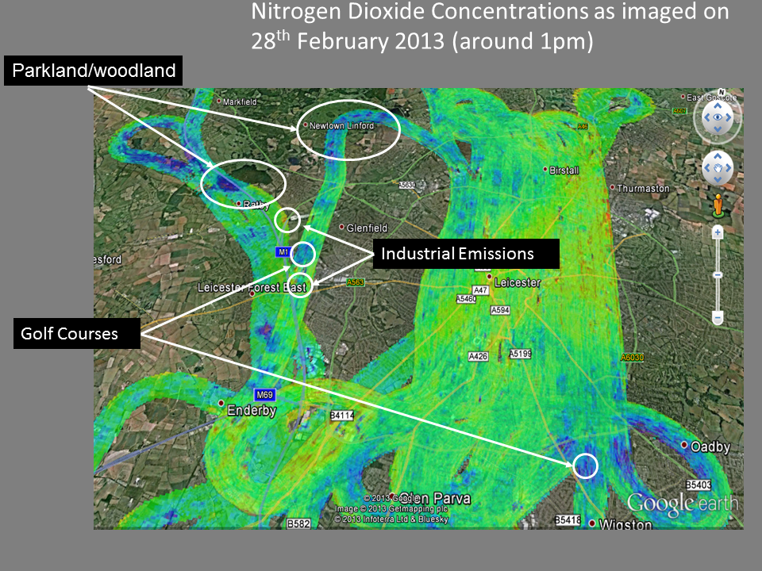
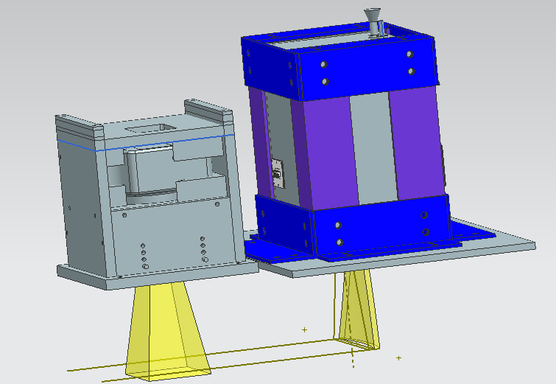
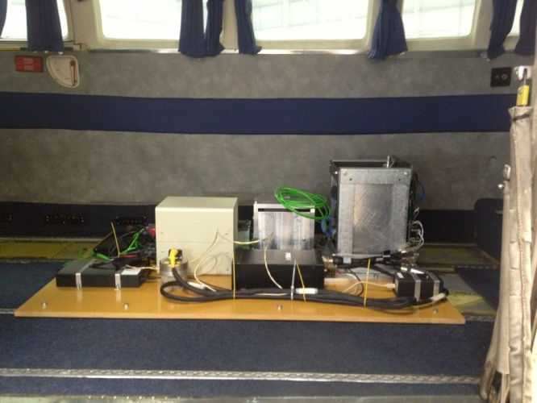
NO₂: Airborne Mapping
Dr Roland Leigh and Dr James Lawrence

Slide 26
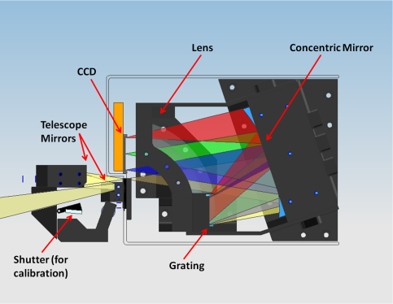
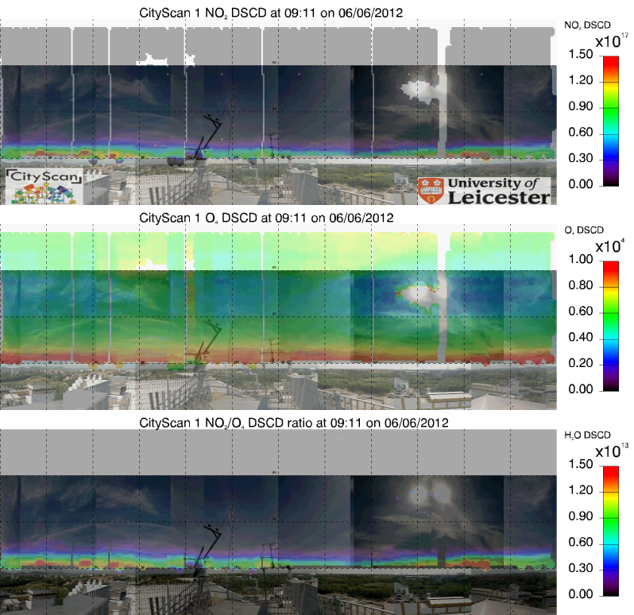
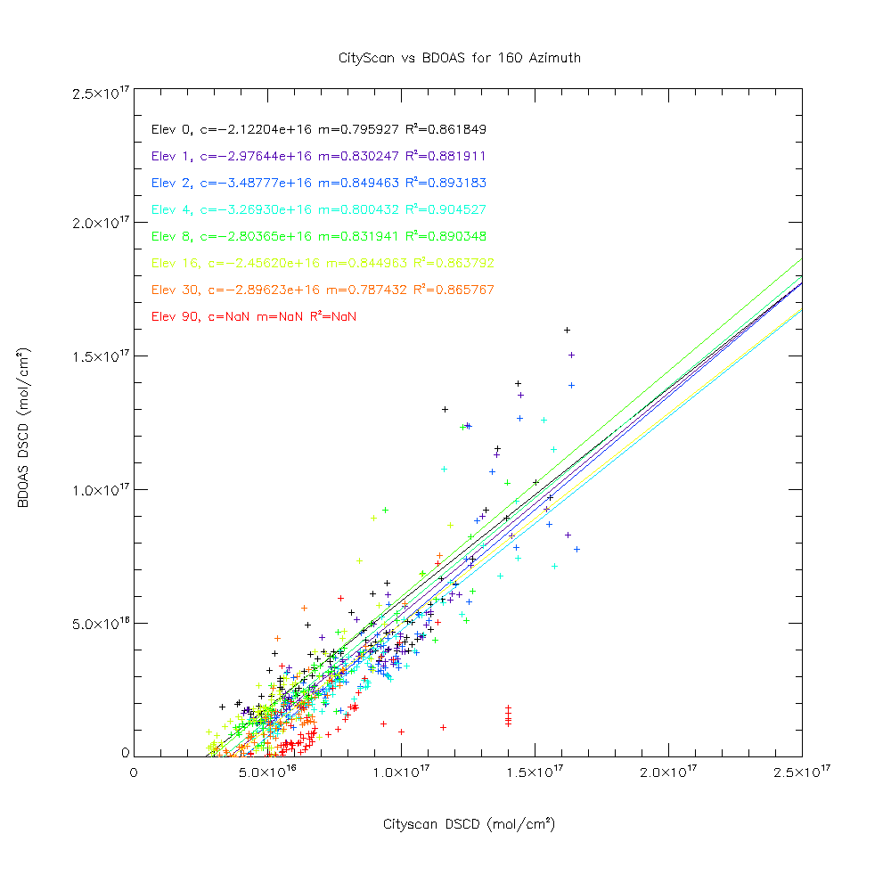
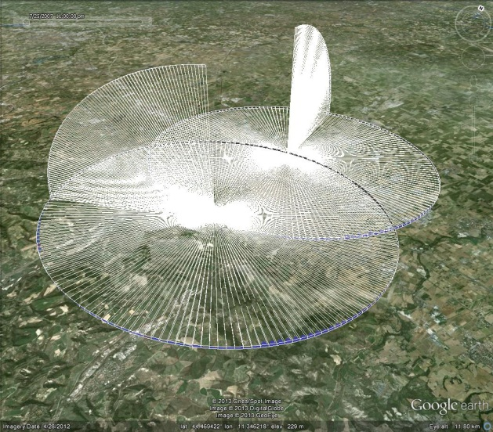
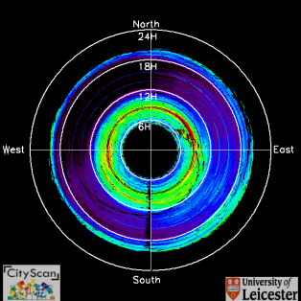
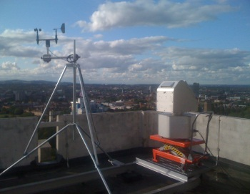
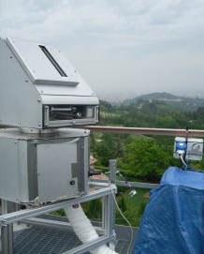
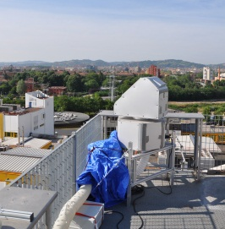
NO₂: Ground-based Mapping
Optical Layout
S
W
N
E
S
Comparison with MAX-DOAS instrument in Bologna
Example CityScan output
The 5° viewing angle by time and direction
Instantaneous FOV and footprint of 2 CityScan instruments
Leicester
Italy
Italy
London
London
London
Rosemarie Graves, Dr Roland Leigh and Dr James Lawrence

Slide 27
NO₂: Modelling and data assimilation
Dr Roland Leigh and Dr James Lawrence

Slide 28
GOSAT
First dedicated Greenhouse Gas measuring satellite
Launched on 23 January 2009
Payload carries 2 instruments:
TANSO Fourier Transform Spectrometer (FTS):
Provides spectrally-resolved radiances for 4 shortwave-IR (polarized) and thermal-IR bands
Covers several absorption bands of CO₂, CH₄, O₃ and H₂O (and others) and O₂
Cloud aerosol imager (CAI):
4 broadband channels from UV to SWIR with high spatial resolution
Provides aerosol and cloud information required for the GHG retrieval

Slide 29
Methane observations
Dr Robert Parker

Slide 30
Validation against ground-based measurements
Dr Robert Parker

Slide 31
Validation against ground-based measurements
Dr Robert Parker

Slide 32
Summary
University of Leicester continuing to be very active in the field of Earth Observation
Long datasets still to be analysed using techniques developed by our team
In a strong position to exploit data from future satellite missions:
Copernicus Sentinel missions
OCO-2 (Orbiting Carbon Observatory)

Slide 33
Thank You for Listening

